Slide 1
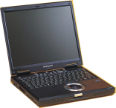
Video Call
SIP video phone is available by P2P using H.263 or H.264. (But Panasonic HD-VC cannot be SIP extension of KX-NS PBX.)
HQ
Branch
SIP Video Software-phone with USB camera
IP Network (VPN)
or
Yealink IP Video Phone VP-2009 Fanvil D800 Android Video Phone http://www.fanvilphones.com/products-d800.php for example
P2P
Some SIP video phone has 2 methods to start video transmission by programming. Type 1 : Video transmission starts automatically when talking starts. Type 2 : Video transmission starts manually by preference of user after talking starts. KX-NS PBX and KX-TDE/NCP support only type 1.
Notes:
1

